Slide 1
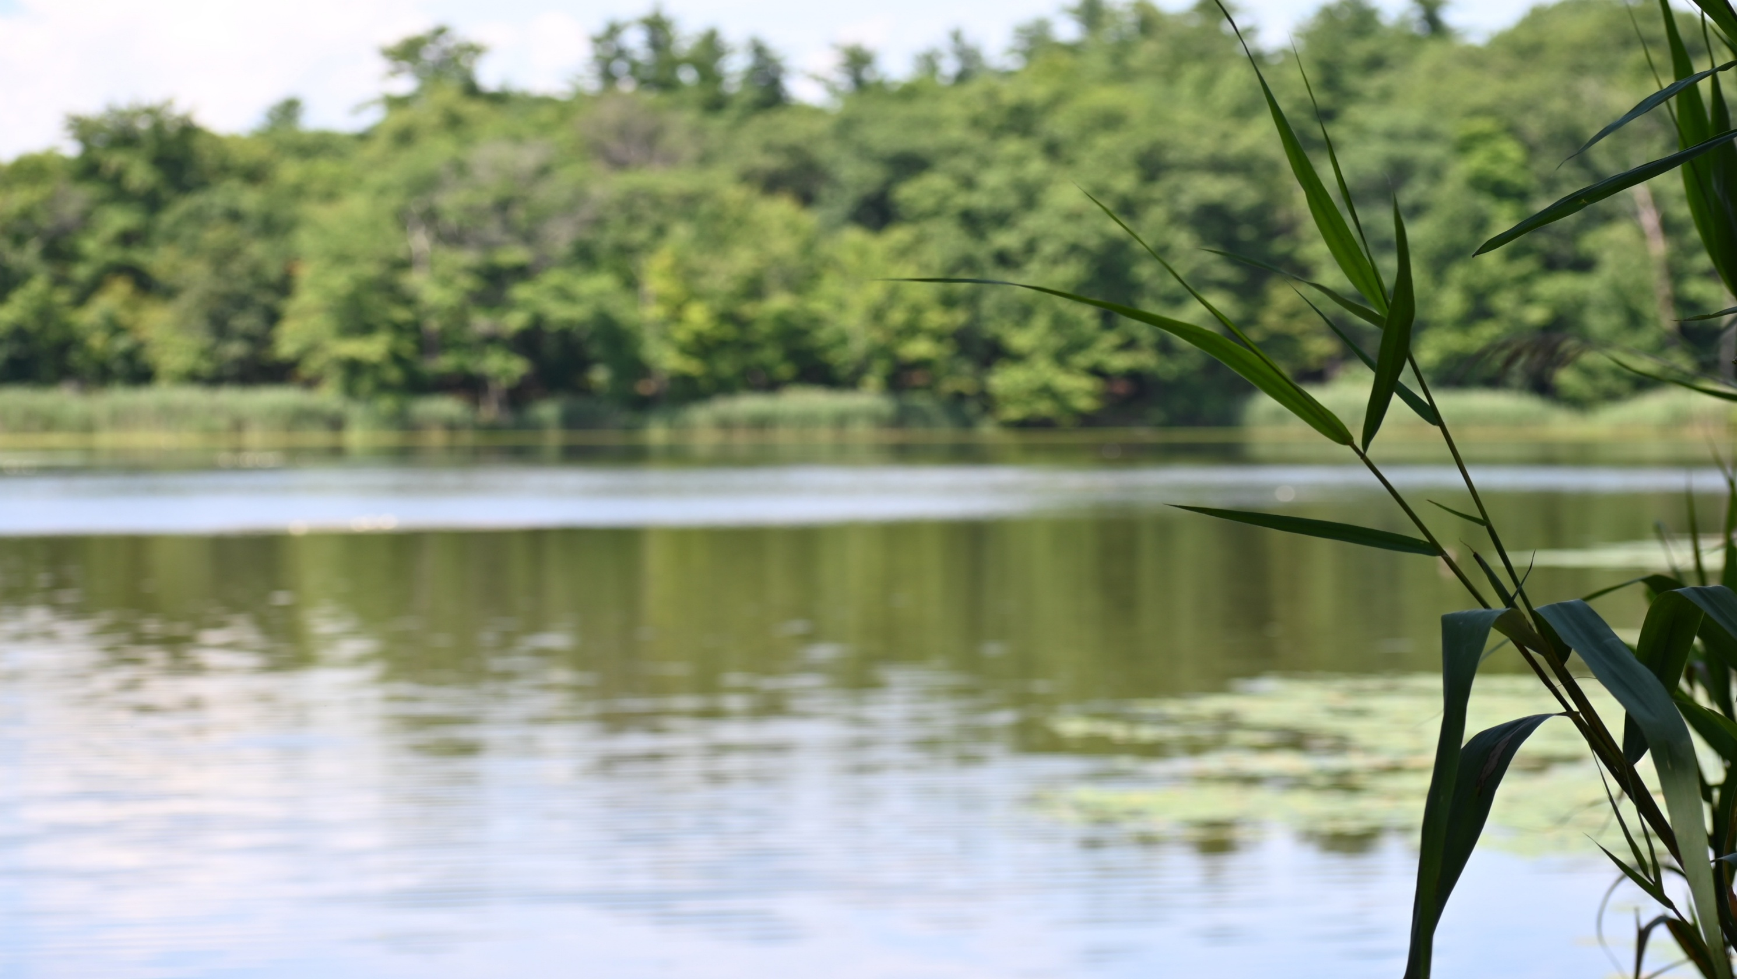

Preparing to Visit Taghkanic Community Forest

Slide 2
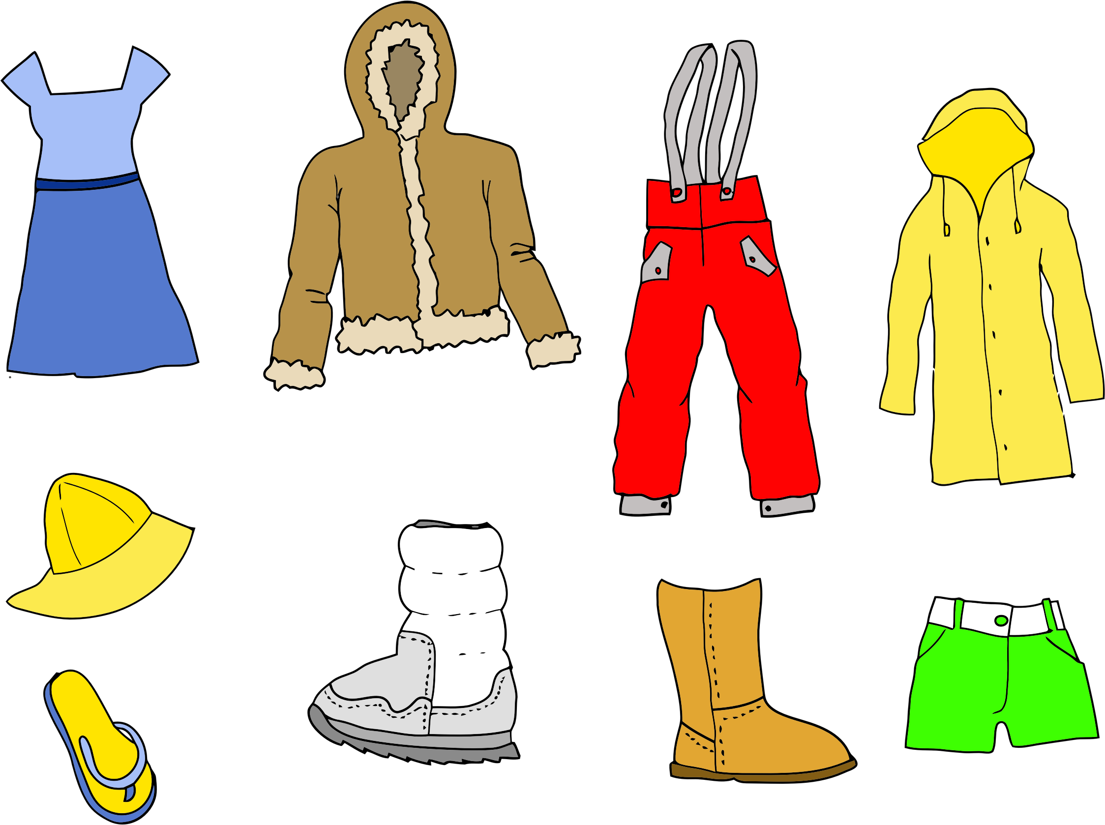




Before I go to Taghkanic Community Forest, I will remember to
wear weather appropriate clothes
fill a water bottle for when I feel thirsty
pack a snack for when I feel hungry
I will also remember that there are no restrooms, so I will use the toilet before going to Taghkanic Community Forest

Slide 3
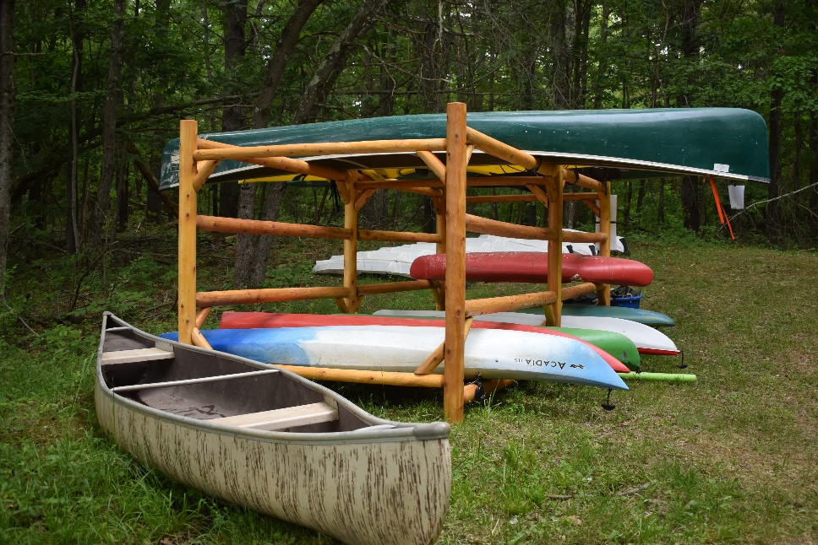
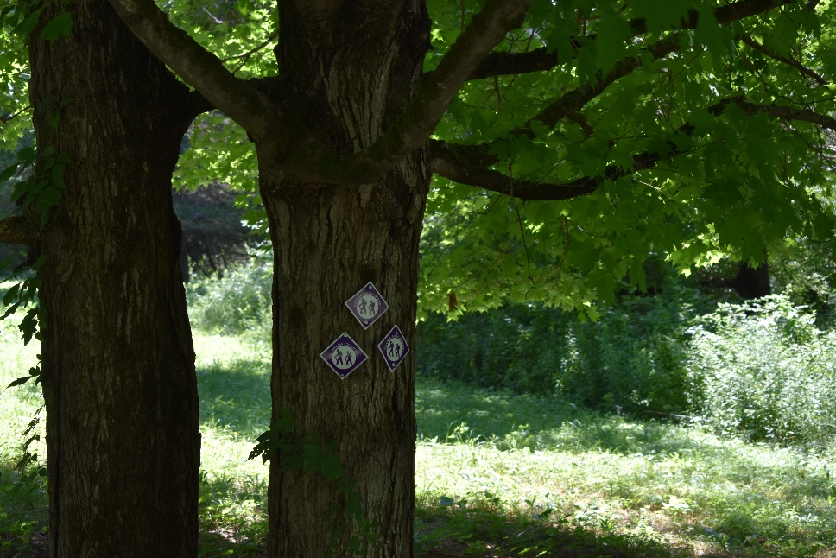
I am excited to go to the Taghkanic Community Forest soon.
I am excited because I enjoy walks in the outdoors and maybe kayaking too.
Taghkanic Community Forest has trails that will take me through the forest, and kayaks to take me on the lake. I will get to use my senses of smell, touch, sight, and hearing to experience nature around me.

Slide 4
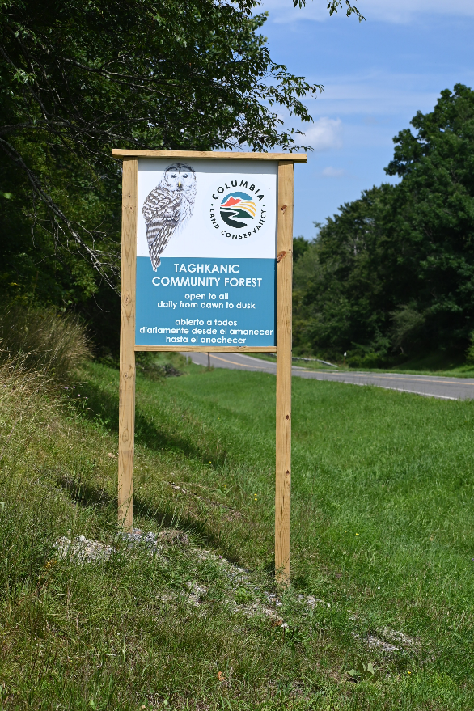
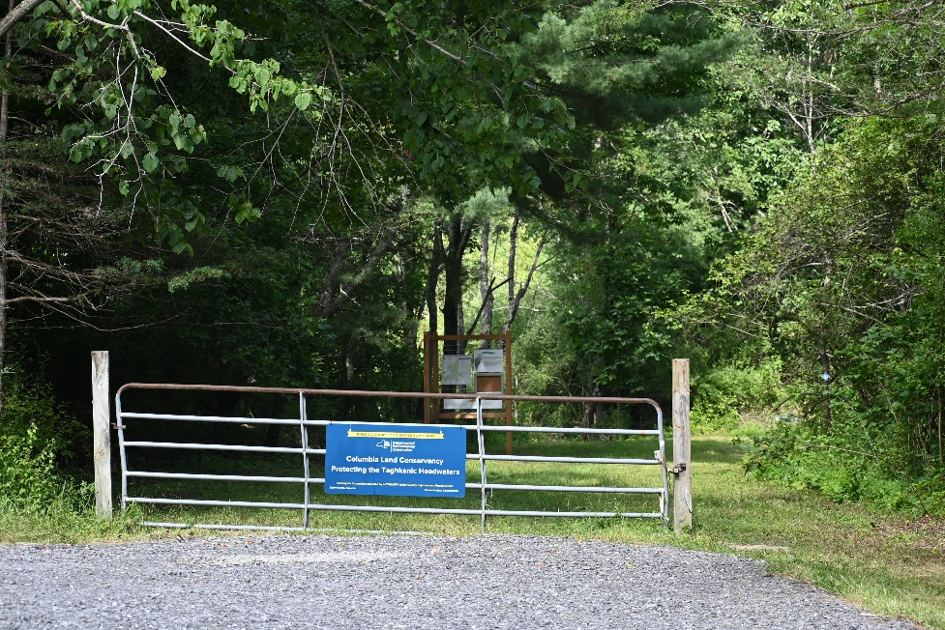
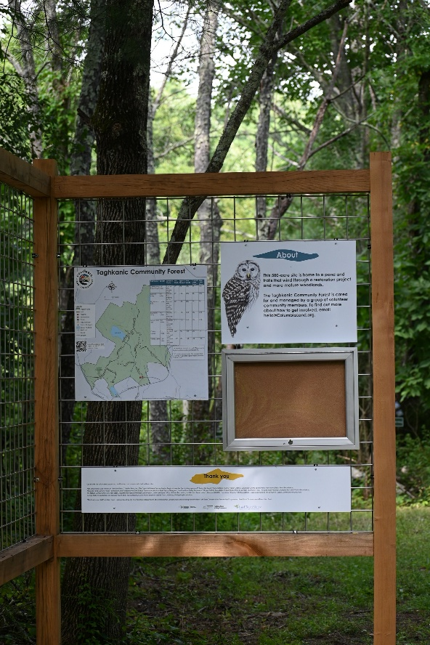
First, I will see the sign that says we have arrived at Taghkanic Community Forest
Then we will park in the parking lot and look at the map to decide what trails to take.
I will be ready for my adventure with my water, snack and plan.

Slide 5
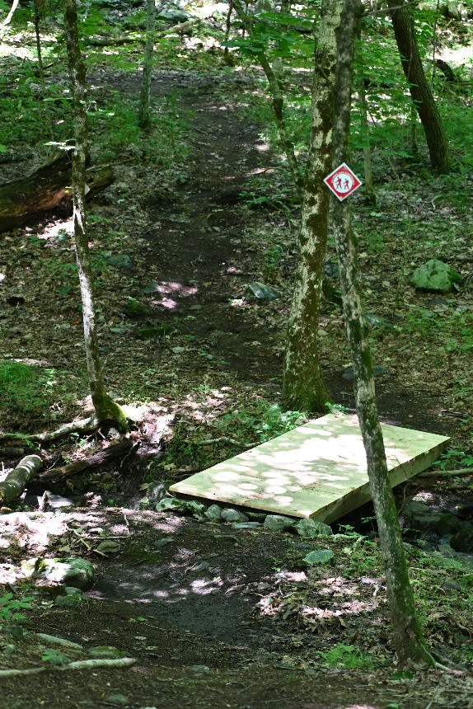
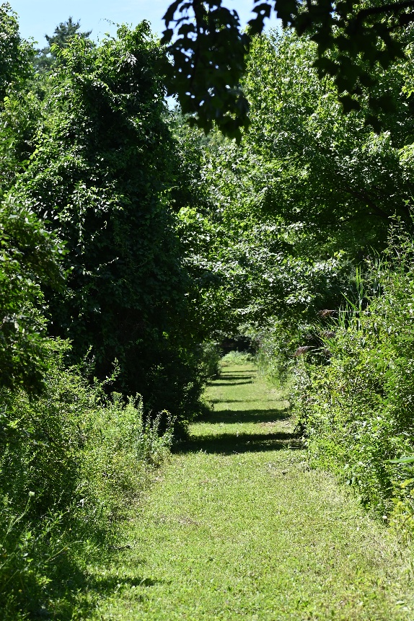
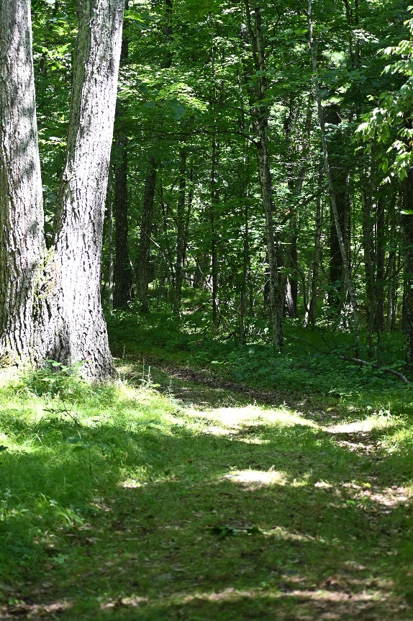
Some of the trails at Taghkanic Community Forest are dirt, some are grassy, and others are leafy forest floor. I likely will be stepping over roots and rocks.
I will hear my footsteps make different sounds depending on the surface.

Slide 6
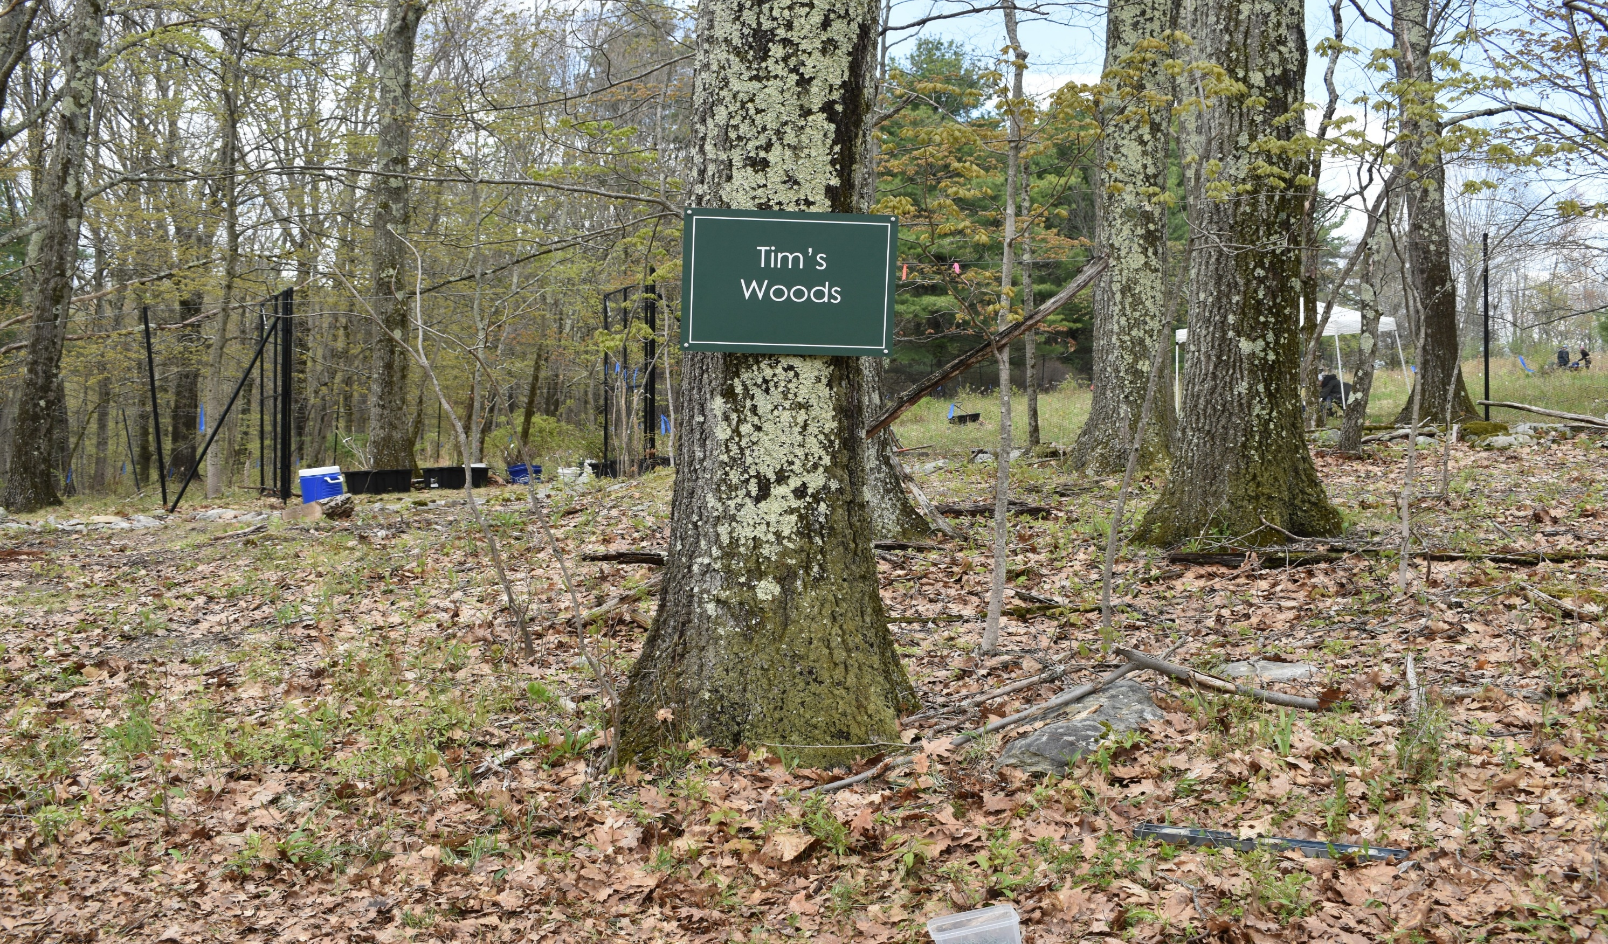
The trails will lead me through the quiet forest.
There is a bench to rest my legs at Tim’s Woods.

Slide 7
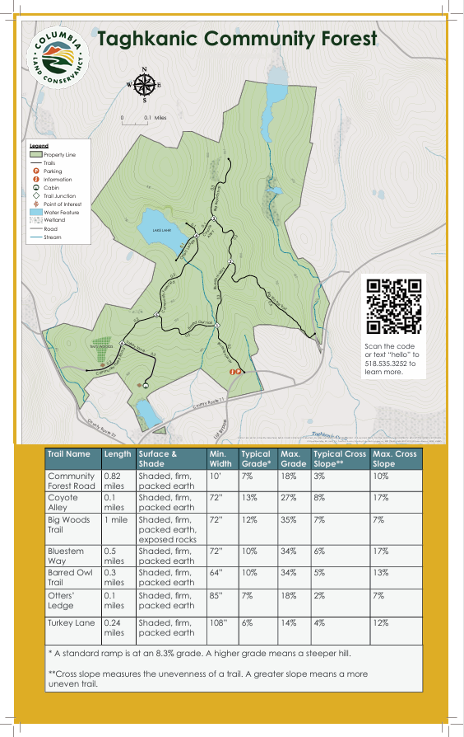
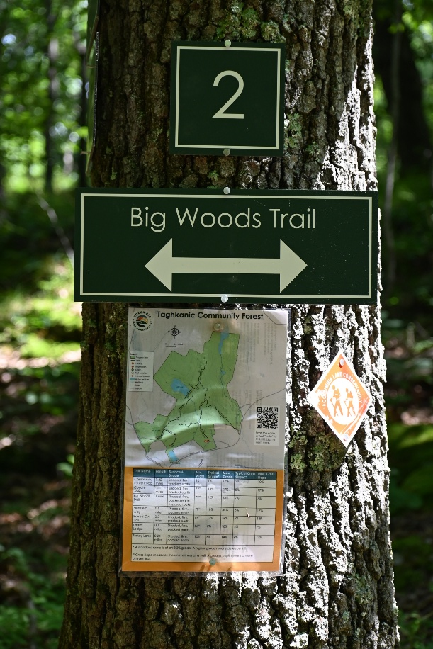
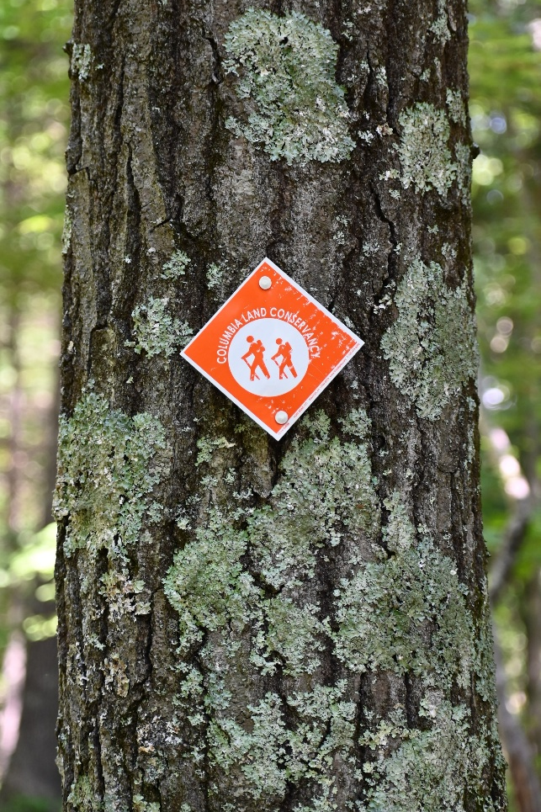
I will carry a map of Taghkanic Community Forest with me and I will look at it at during my walk. It will help me see where I am and where I am going. I will also use the signs to help me stay on the right trail.

Slide 8
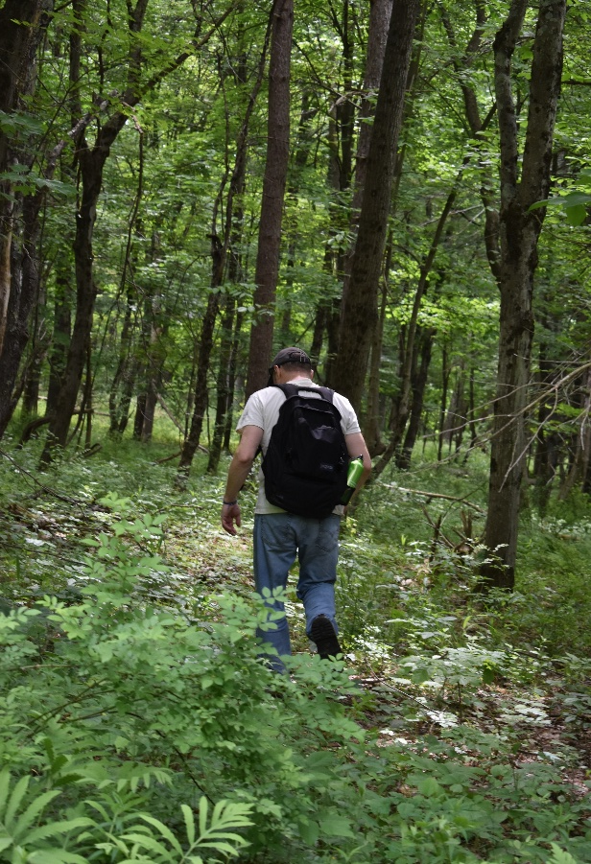
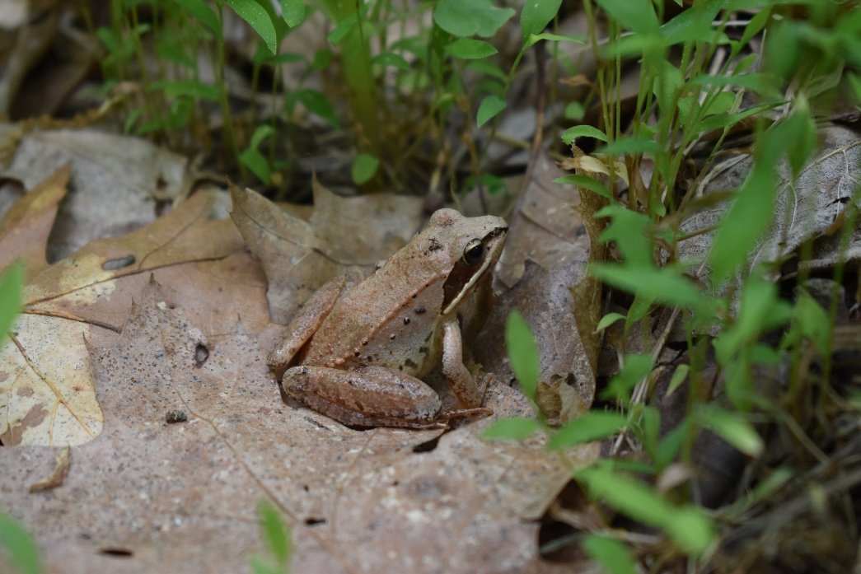
When we are done exploring Taghkanic Community Forest, we will walk back to the parking lot and drive home. I will reflect on all the plants and animals that I saw or heard. I will also appreciate the fun time that I spent outside.

Slide 9
Additional Info for Caregivers
There are no restrooms or trash cans ​
Dogs should be leashed at all times​
Be sure to check for ticks after your visit ​
Kayaks are free and located on site. Please fill out this form to use them.
Listen for birds in the forest, especially in springtime
Look for frogs and other amphibians by the lake in the spring and summer.
Public Lands FAQs:
Ways to Engage:

